Slide 1

Predicting best neighborhood for a new restaurant

Slide 2
Business problem:
Challenge is to find a suitable location in Toronto for a new restaurant along with recommendations regarding the theme and cuisine that would comply with the demands of the restaurant owner.
Target Audience:
Business personnel
Investors or owners looking for expansion
Real estate dealers
Data science enthusiasts

Slide 3
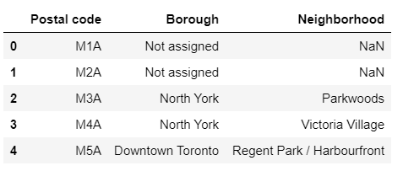
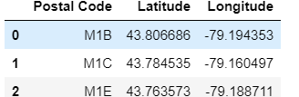
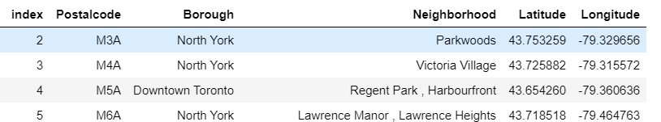
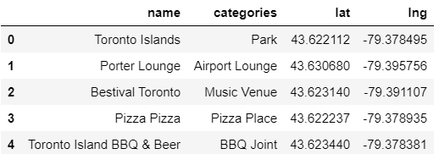
DATA COLLECTED:
1.List of neighborhoods in Toronto
2.Geospatial data regarding the neighborhoods
3.Venues around neighborhood

Slide 4
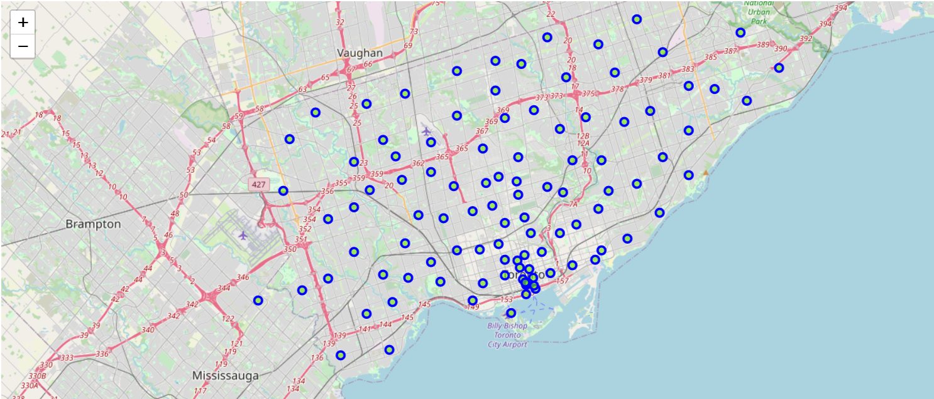
Neighborhoods in Toronto:
Total of 103 neighborhoods determined along with borough

Slide 5
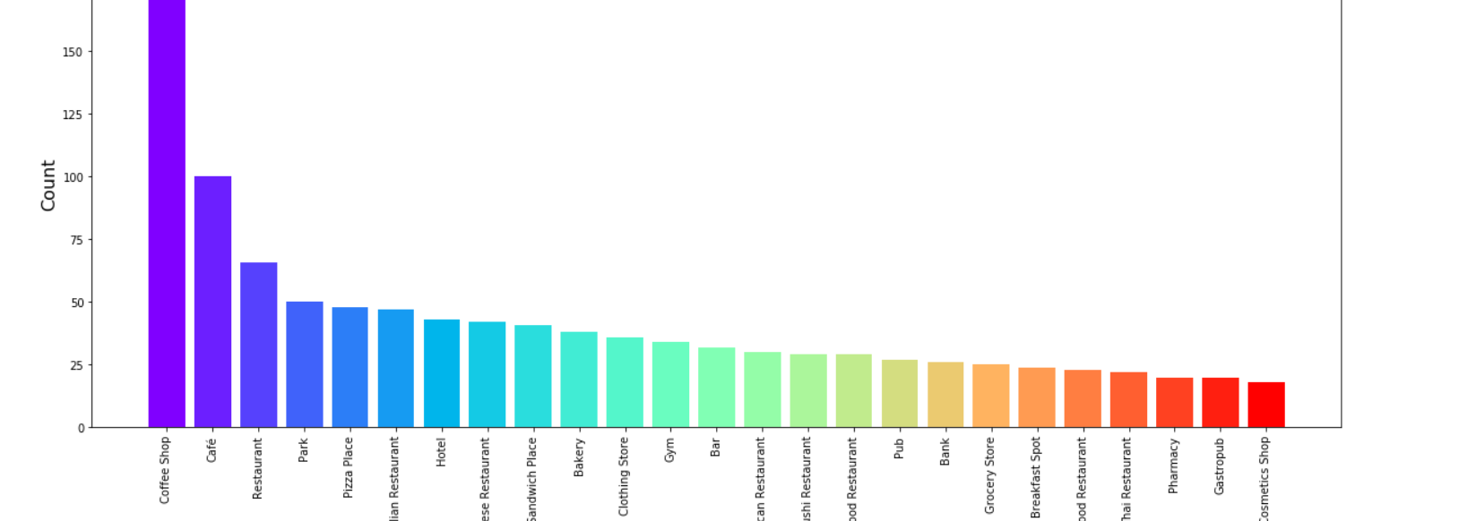
Venue category distribution plot:
Most common venues obtained- coffee shops, café and restaurants

Slide 6
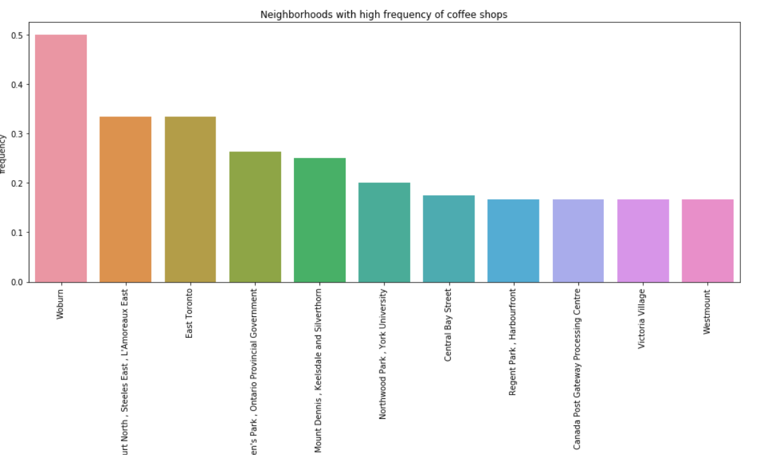
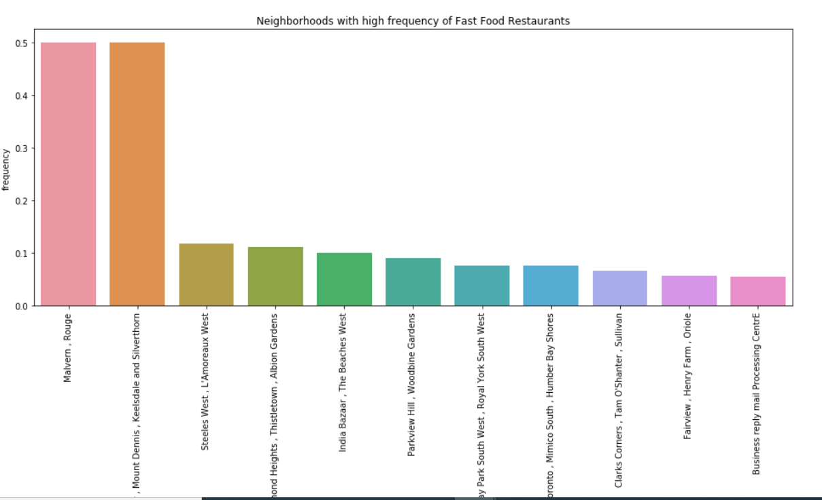
Neighborhood with high frequency of Coffee Shops
Neighborhood with high frequency of food restaurants

Slide 7
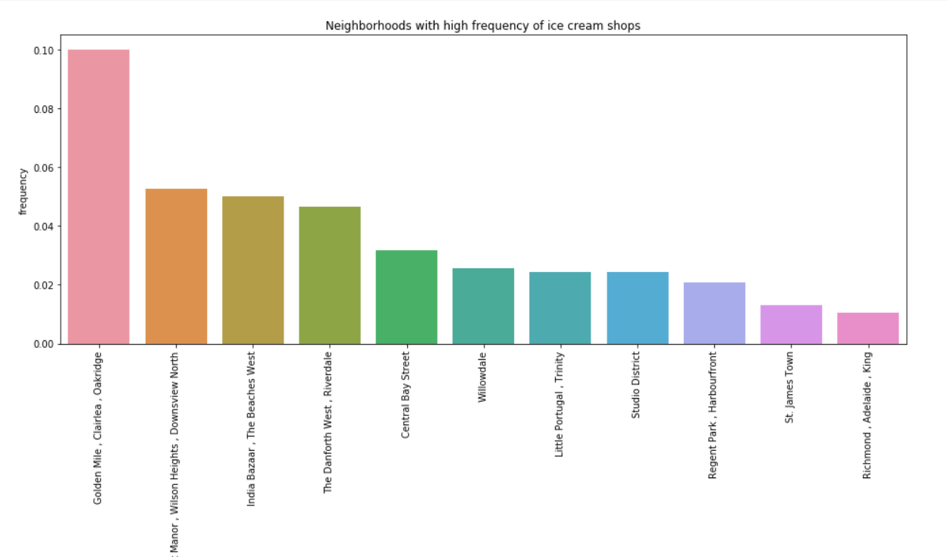
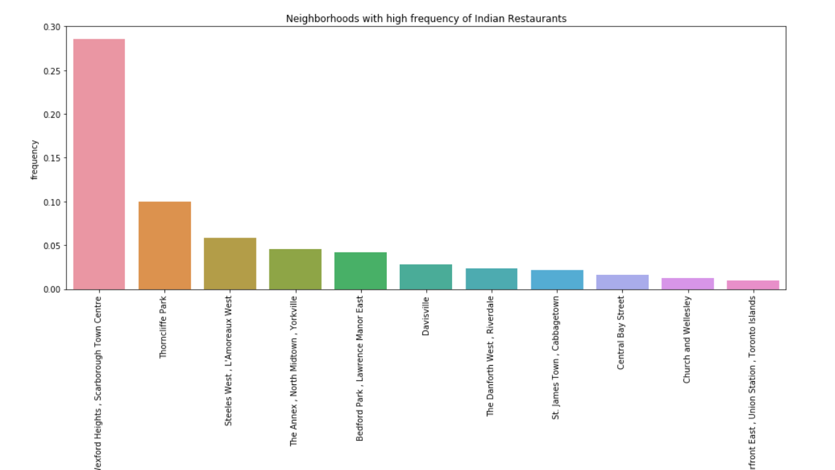
Neighborhood with high frequency of Ice cream shops
Neighborhood with high frequency of Indian Restaurents

Slide 8
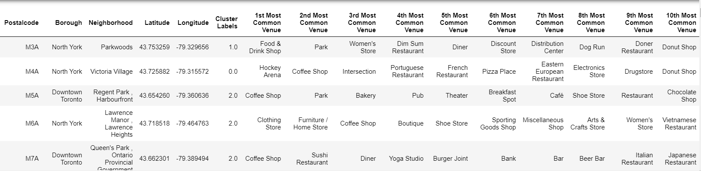
All Neighborhood with top ten most common venues:

Slide 9
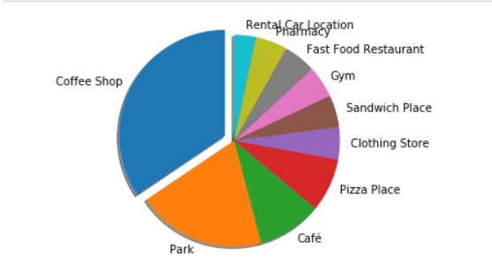
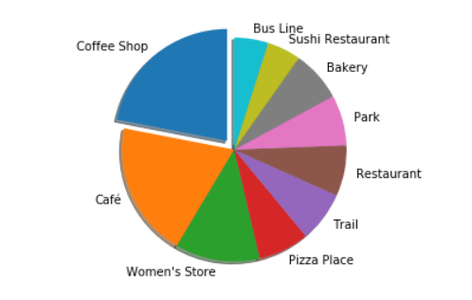
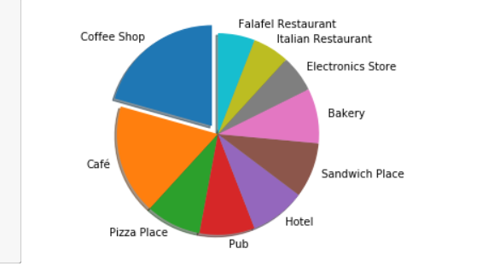
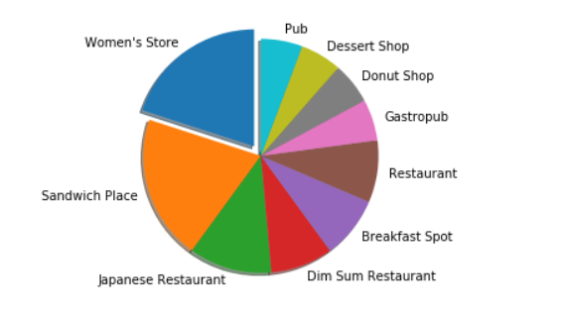
Distribution of different venue categories in Toronto as first , second, third and fourth most common venues : Coffee shops being prominent
1. First most common venue

Slide 10
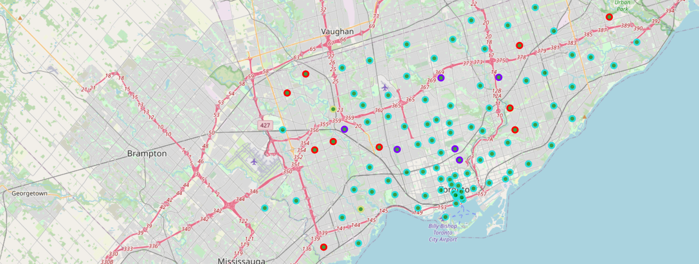
Clustering Neighborhoods based on venue information:

Slide 11
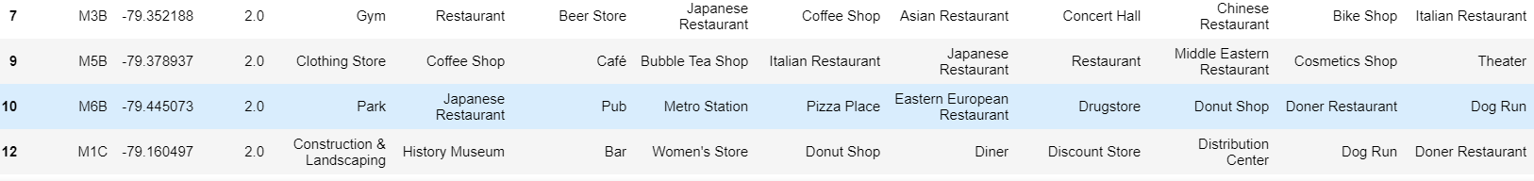
RESULTS:
Based on clustered date,
Coffee shop:
Coffee shops seems to be a best option for investment
2. If a coffee shop is in the demand set of investor, we can go ahead with the plan of undertaking this project of new coffee shop
3. Data from cluster 2 would be utilized for selecting a suitable neighborhood .
Some of the preferred neighborhoods would be with postal codes, M3B,M1C and M6B
4. Further analysis can be done based on population density, number of shops in the area and competitors to select a final location

Slide 12
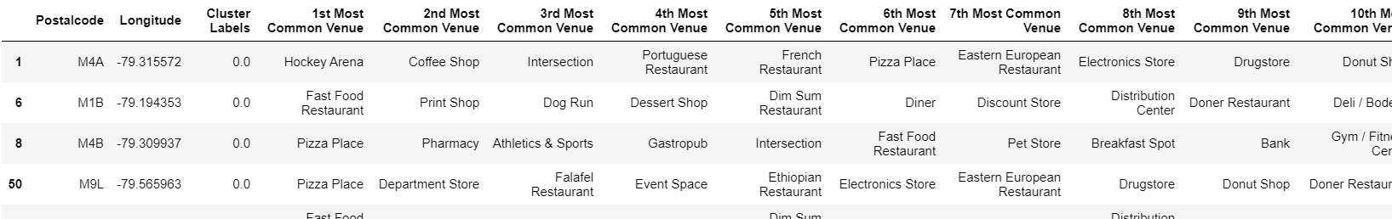
Alternate option:
1.If coffee shop is not in the consideration set of investor, then the next best alternative would be restaurants as this category appeared next in the distribution plot
2. For restaurant, cluster 0 data would be utilized as this cluster has a high number of restaurants
3. Location in cluster 0 would be again based on other parameters like population.
4. Further analysis in terms of Ethnicity of the neighborhood would be useful in
determining the type of restaurant along with the theme
5. As of now, we can recommend neighborhoods with postal codes M8W and M9V

